Slide 1
A Functional Approach to Performance Portable GPU Code Generation
A Case Study on Matrix Multiplication
Toomas Remmelg, Thibaut Lutz, Michel Steuwer, Christophe Dubach

Slide 2
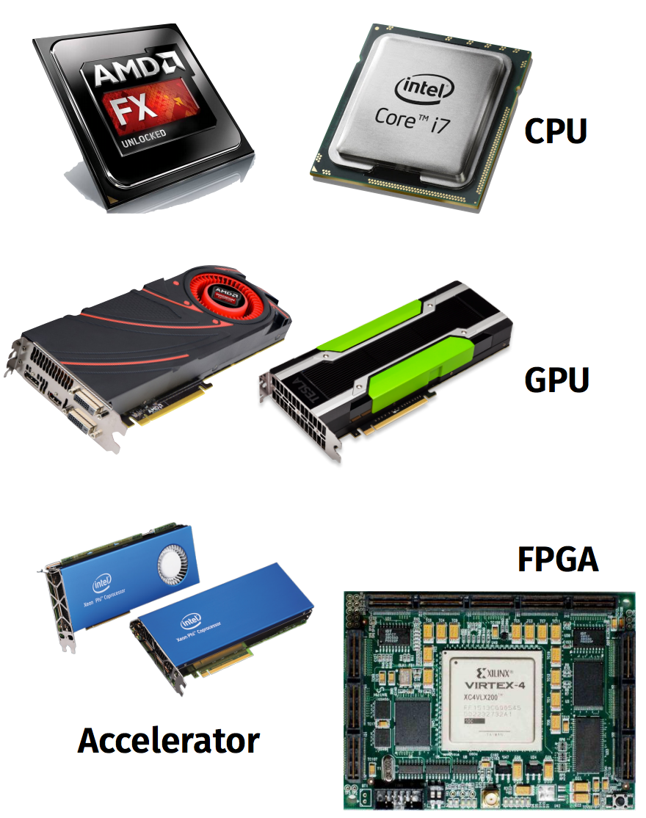

The Problem
Parallel processors everywhere
Many different types: CPUs, GPUs, …
Parallel programming is hard
Optimising even harder
Problem: No portability of performance!
Notes:
it is possible to write portable code but not performance poryable
explain portability

Slide 3
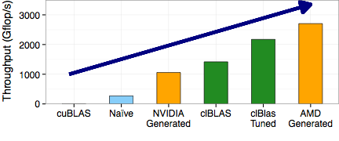

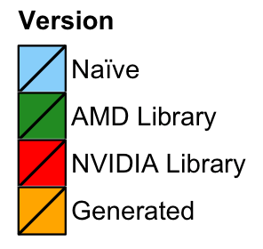
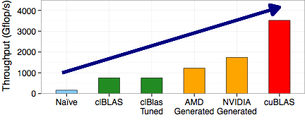
Performance Portability of Matrix Multiplication
AMD
NVIDIA
Notes:
Higher is better
1. naive -> terrible everywhere; ~10x slower than us on AMD, on NV ~10x slower than ours ~20x slower than cublas
2. tuned library -> good, autotuning -> better 50% faster
, but not performance portable and we’re still 25% better
on a different arch tuning useless, 2.3x slower than us on on NV
3. highly tuned library (assembly + device/arch specific) best 2x over us, not portable or existing
4.
nvidia generated on amd 2.7x slower
amd on nvidia 1.4x

Slide 4
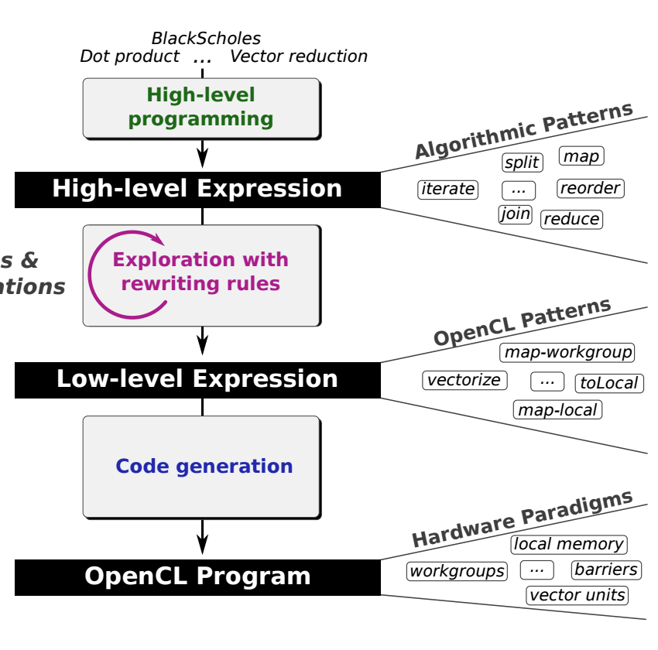
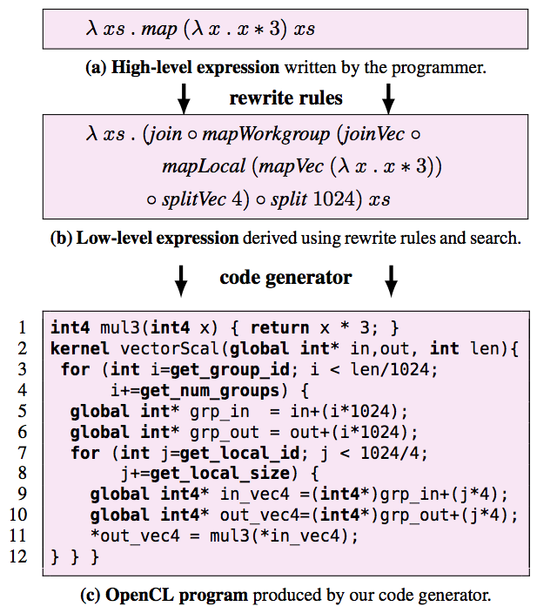
Generating Performance Portable Code Using Rewrite Rules
Notes:
General approach, published at ICFP
explain rewriting
Explain OpenCL: workgroup, local memory, barrier
THIS TALK, MATRIX MULT!

Slide 5
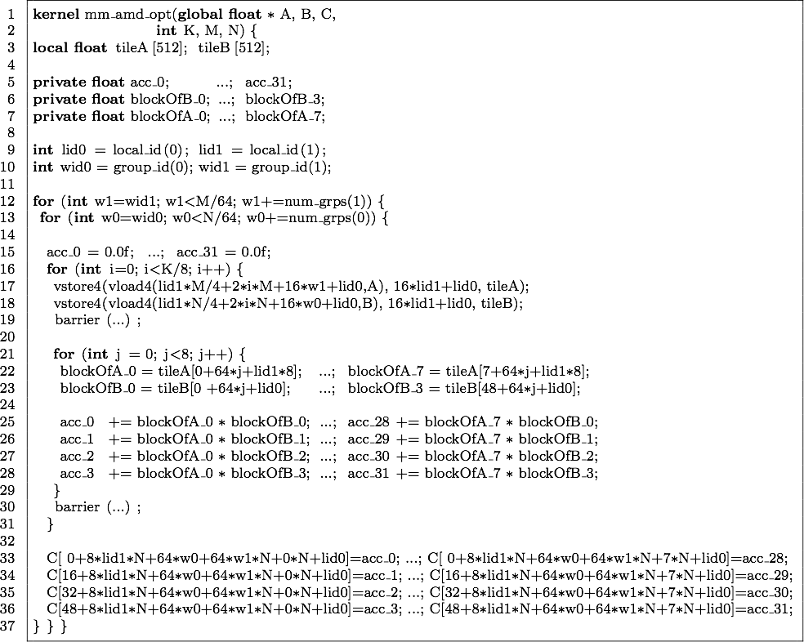
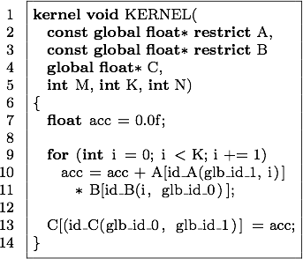
Matrix Multiplication in OpenCL
Naïve
Generated for AMD
Notes:
difficult to achieve in OpenCL
implicit outer for loops
what are M, K, N? compiler doesn’t know

Slide 6
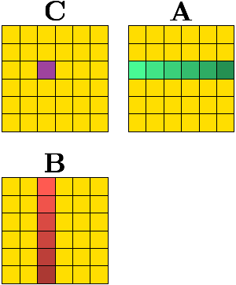
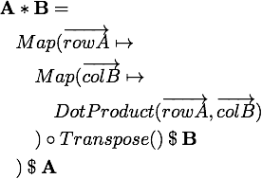
Functional Definition of
Matrix Multiplication
Notes:
explain notation

Slide 7
Traditional Optimisations
Register Blocking Loading elements into registers and reusing them.
Tiling Solving the problem by diving matrices into smaller tiles.
Vectorisation Using wider vector units if available.
Why can’t this be automated by traditional compilers?
Complex analysis Proving the optimisations are legal.
Conservative Must always be correct.
No obvious defaults for parameters Good tile and block sizes depend on hardware capabilities.
Notes:
first two increase locality and reuse

Slide 8
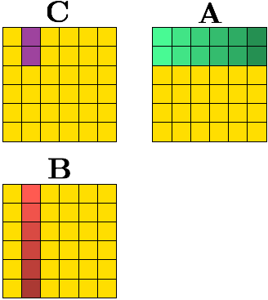
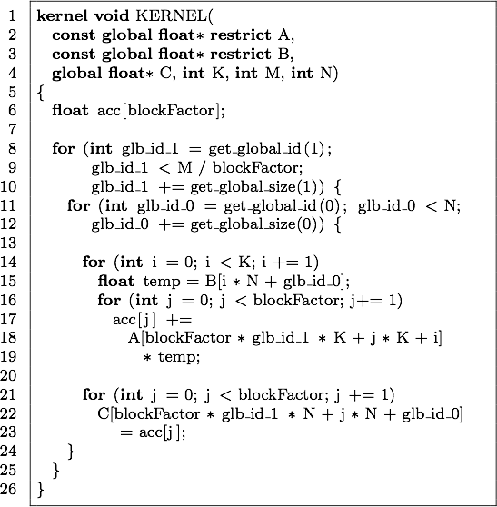
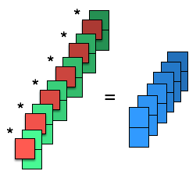
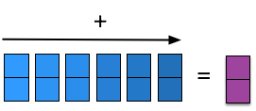
Register Blocking
}
blockFactor
Notes:
we: series of rewrites => optimisation

Slide 9
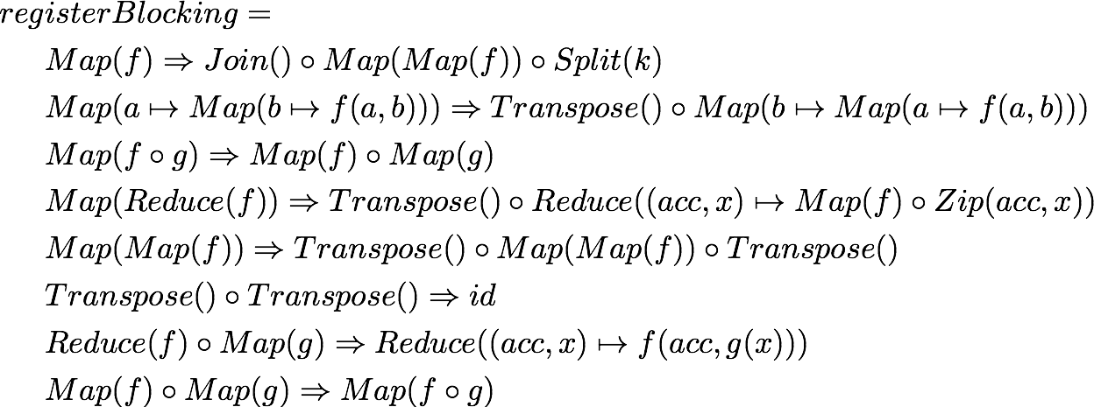
Register Blocking
as a Series of Rewrites

Slide 10
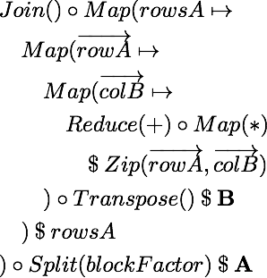
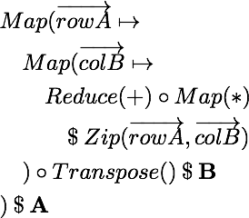
Register Blocking
Notes:
split-join, divide and conquer REWRITE, NOT OPTIMISATION

Slide 11
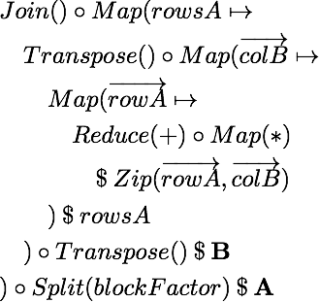
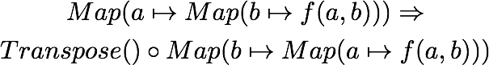
Register Blocking
Notes:
map(map) interchange

Slide 12
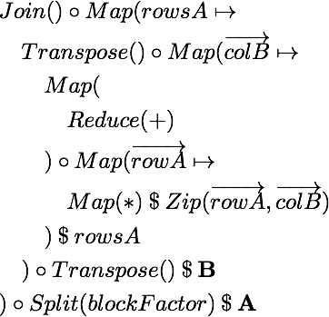
Register Blocking
Notes:
map fission

Slide 13
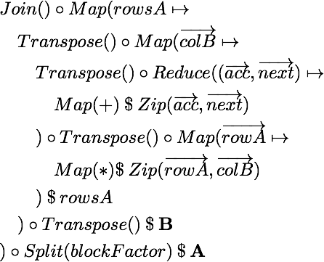
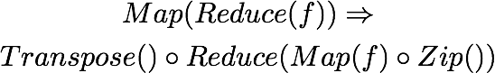
Register Blocking
Notes:
map(reduce) interchange

Slide 14
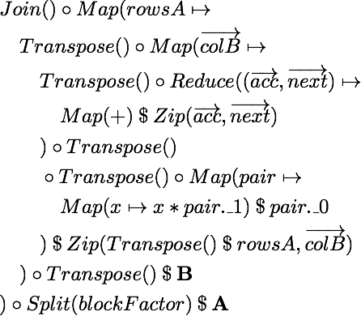
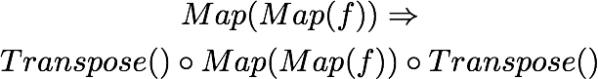
Register Blocking
Notes:
map(map) interchange

Slide 15
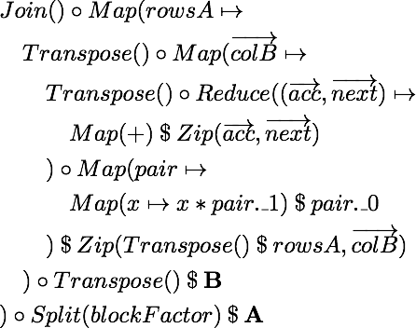
Register Blocking

Slide 16
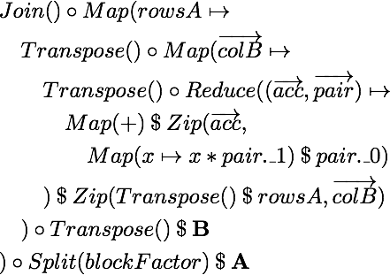
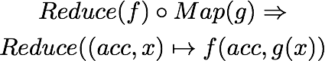
Register Blocking
Notes:
map-reduce fusion

Slide 17
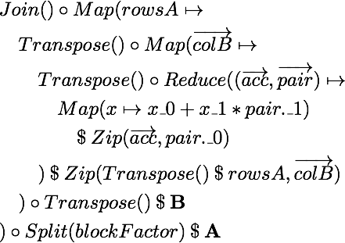
Register Blocking
Notes:
map-map fusion

Slide 18
Register Blocking
}
blockFactor

Slide 19
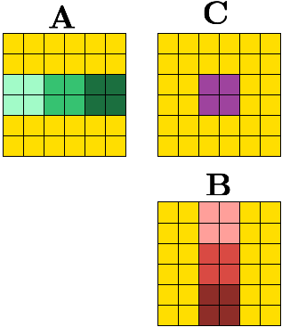
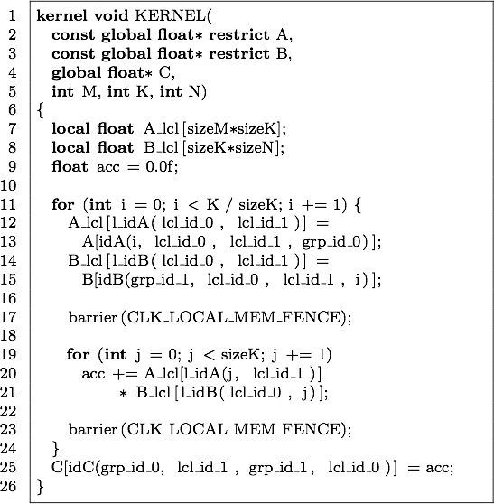
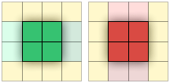
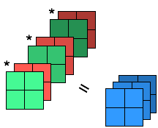
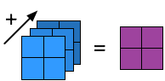
Tiling
sizeK
{
{
sizeM
{
sizeK
{
sizeN
Notes:
workgroup of threads
small, fast local memory

Slide 20
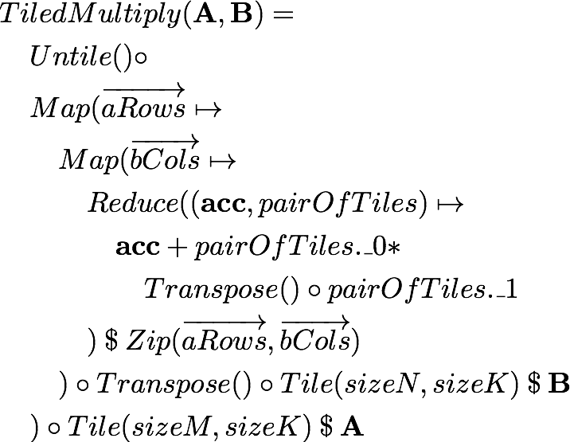
Tiling
Rewriting

Slide 21
Tiling
{
sizeM
{
sizeK
{
sizeK
{
sizeN

Slide 22
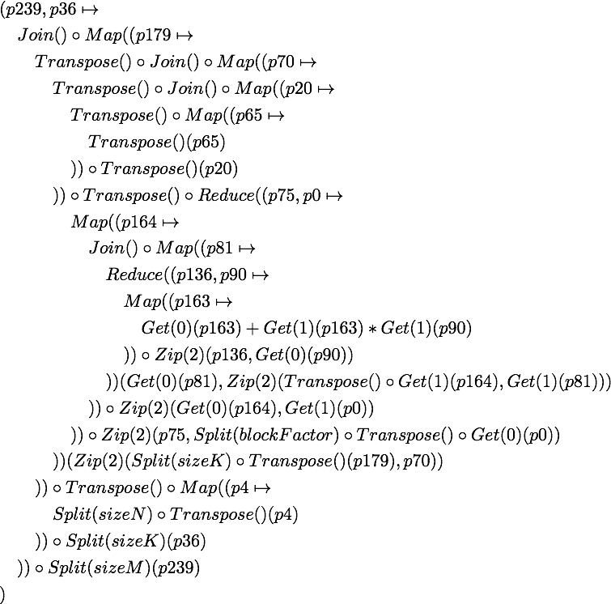
Combining Optimisations
80 rewrites

Slide 23
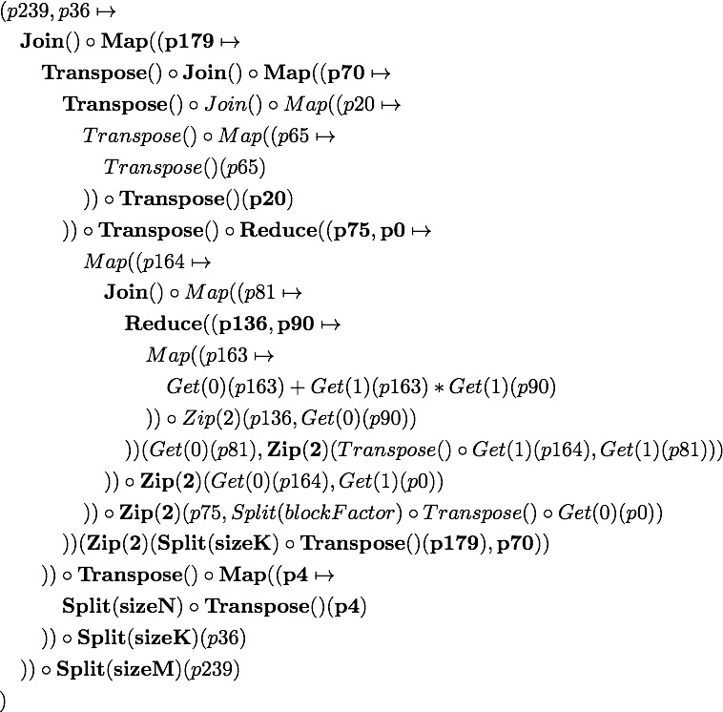
Combining Optimisations
Tiling

Slide 24
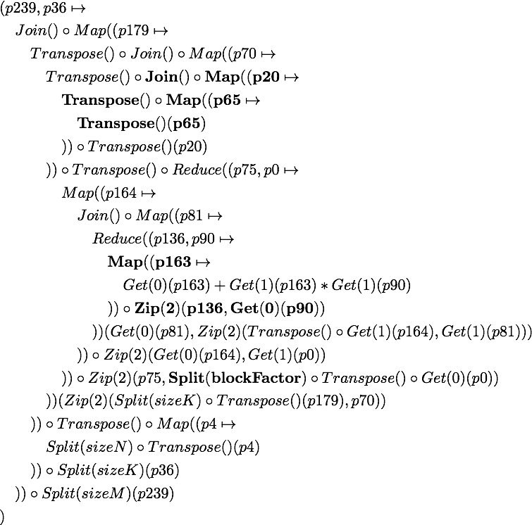
Combining Optimisations
Blocking

Slide 25
Combining Optimisations
80 rewrites
Notes:
explain macro rules,
depth 80 is too much, huge tree, and it’s not even the fastest one which is deeper

Slide 26
Macro Rules
A macro rule is a rewrite rule that has a particular goal and can apply different rewrite rules to achieve it.
Examples:
1D Register Blocking, 2D Register Blocking
Tiling
Map-Map Interchange

Slide 27
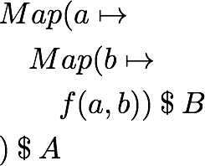
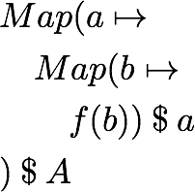
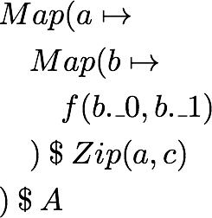
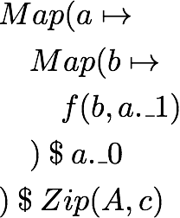
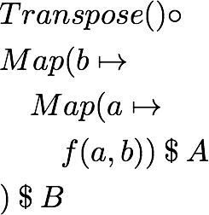
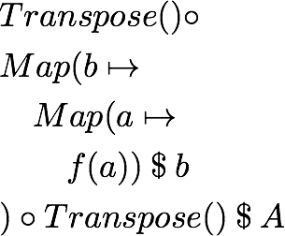
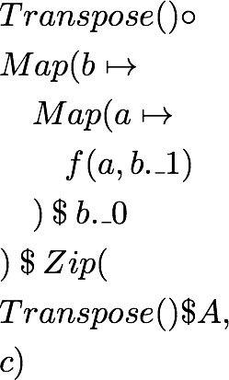
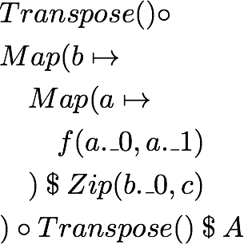
Map-Map Interchange Macro Rule

Slide 28
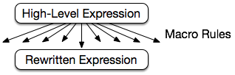
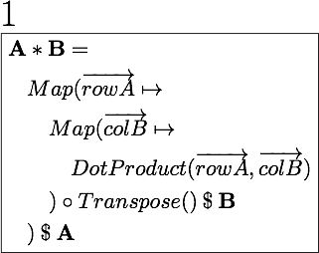
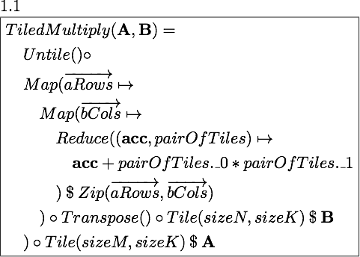
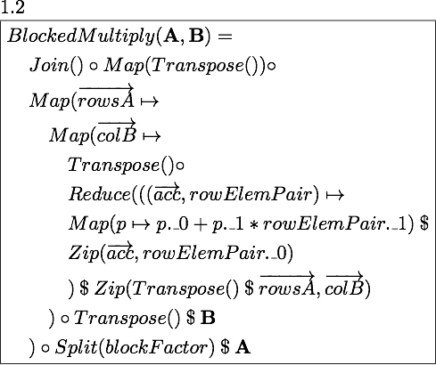
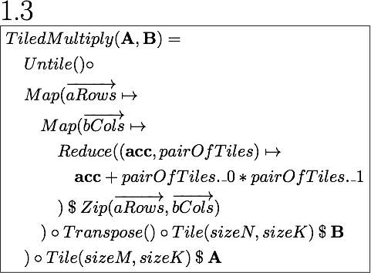

Exploration Strategy

Slide 29




Exploration Strategy
Notes:
Rewritten has MapWrg

Slide 30







Exploration Strategy
Notes:
sizes

Slide 31

Exploration Strategy
Notes:
Explain heuristics

Slide 32
Heuristics
For Macro Rules:
Nesting depth
Distance of addition and multiplication
Number of times rules are applied
For Parameter Mapping:
Amount of memory used
Global
Local
Registers
Amount of parallelism
Work-items
Workgroup
For Map to OpenCL:
Fixed parallelism mapping
Limited choices for mapping to local and global memory
Follows best practice
Notes:
parameter mapping -> expert knowledge about gpus

Slide 33
Exploration in Numbers
1
8
760
46,000
Notes:
AFTER FILTERING; filtering throughout
tiny portion
lowering, quick
codegen 30min-60min
execution of all 46,000 OpenCL kernel took less than an hour on Tahiti and Kepler and about three hours on Fermi, including the overheads of data transfers, validation, etc. but excluding the kernel generation and compilation time.

Slide 34

Exploration Space
Notes:
Explain platforms
Overall explored space

Slide 35

Performance Evolution
Notes:
best so far
random

Slide 36

Performance Evolution
Notes:
best so far, random
LOGARITHMIC
dot = 90% of best found
on average runtime for 1K 10ms (Tahiti), 26ms (Kepler), and 60ms (Fermi)

Slide 37

Performance Results
Notes:
BEST VERSIONS, Explain GPUs, 2 gen NVIDIA + 1 AMD
MAGMA -> academics, CUDA + OpenCL, open source
cuBLAS -> why so good, different versions for different gpus
clBLAS -> vendor tuned, autotuning parameters but not structure.

Slide 38

Performance Portability
Notes:
explain axes
Mention generations
NVIDIA fermi/kepler
AMD tahiti

Slide 39
Performance Portability
Notes:
Mention generations NVIDIA fermi/kepler AMD tahiti
DARKER IS BETTER

Slide 40
Performance Portability
Notes:
Mention generations NVIDIA fermi/kepler AMD tahiti
X did not run
nvidia on amd because too large work-groups
AMD ones have wrong code…

Slide 41
Conclusion
OpenCL code is not performance portable
Using a functional approach along with rewrite rules we can generate performance portable code
Performance of matrix multiplication on par with tuned OpenCL code
Toomas Remmelg - toomas.remmelg@ed.ac.uk

